Slide 1
Progress Seminar
Team 10
Mohamed Regaieg
12/4/2017

Slide 2

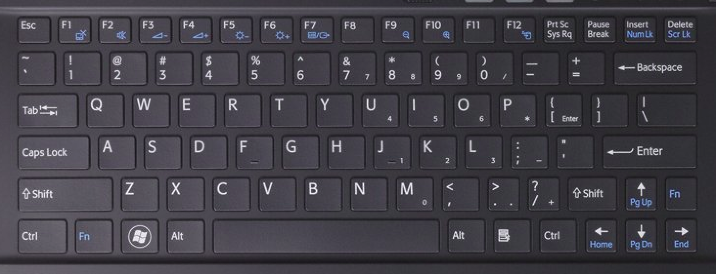
Driver Interface
Use of the keyboard to control the recovery system.
Implementation of a first version.

Slide 3
Driver Interface
Available resources:
send_str(char msg[]);
char get_char(void);
Keyboard
Terminal (Standard text editor)
Limitation resources:
Only one key button can pressed at each moment

Slide 4
Driver Interface
Keyboard map:
Key | Function | Key | Function
q/a | Winch step up/down | y/h/n | Three different speeds
z/x | Turn camera one step left/right | i/m | Move the car forwards/backwards
1/2 | Turn light on/off | k | Stop the car
r/f | Raise/lower upper claw | j/l | Turn car left/right
t/g | Raise/lower lower claw | J/L | Spinning the car to the left/right

Slide 5
Driver Interface
Feedback to the driver: after any change the system status will be printed in the terminal:
Positions of the servo
Duty cycle and direction of each DC motor
Light state
Integration of stepper movement for the next version

Slide 6
Driver Interface
Upcoming tasks
Validation with the whole system
Adjusting the control speed of the car
Adjusting the stepwise movement of the servos and the stepper
Improving the feedback

Slide 7
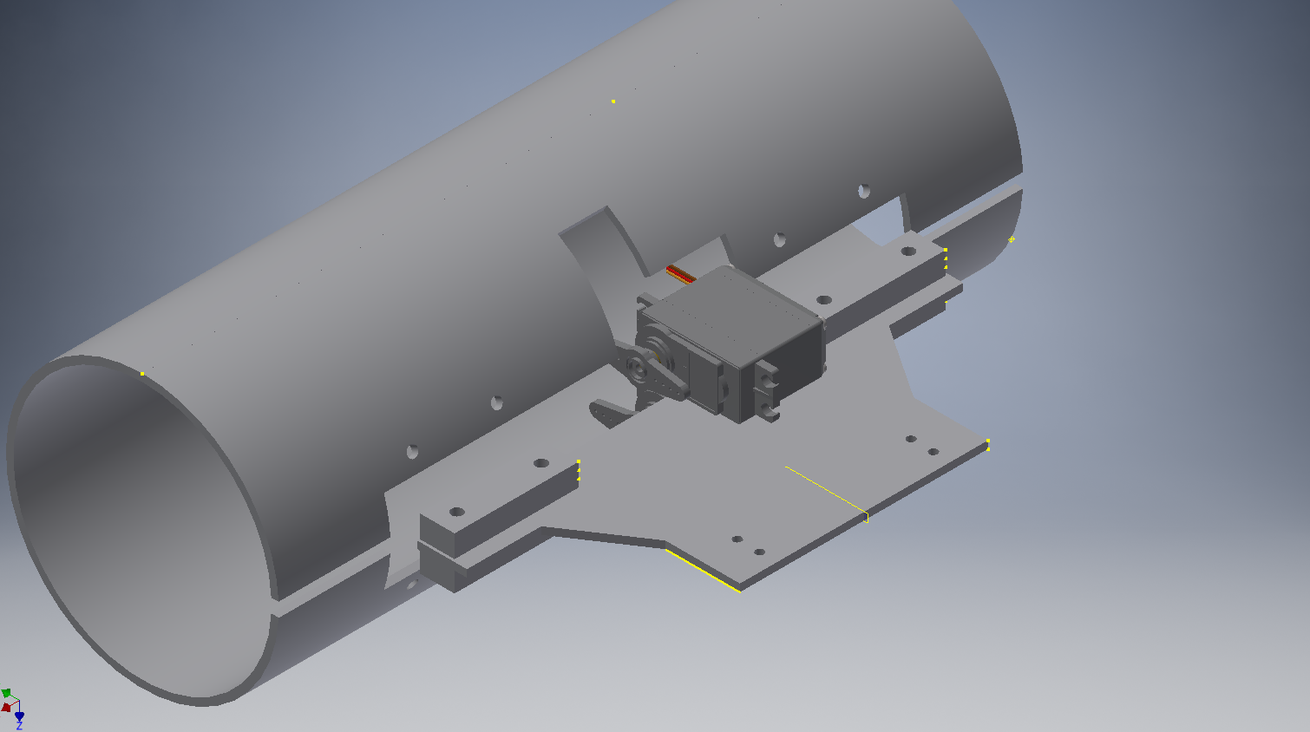
Claw Design

Slide 8
Claw Design
Needed parts:
1 Pipe
2 pipe caps
4 hinges
2 servo motors
1 aluminium plate sheet
4 M4 x 25mm bolts and their nuts
6 M3 x 15 bolts and their nuts

Slide 9
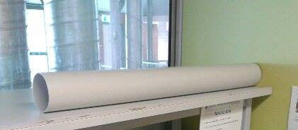
Claw Design
The PVC pipe: DN100 SN6
Inner diameter 104 mm
Large enough:
larger than the widest section of the submarine (72 mm)
Submarine can be inclined (approximately 100 mm are needed)
Used length 300 mm, split into
One quarter: lower claw part
3 quarters: upper claw part.

Slide 10
Claw Design
Servo motors
Torque calculation: assumptions
One rock is grabbed with the submarine
Servo pipe connection at 1 cm from the servo axis
The whole load is acting at the furthest point
100 mm for the upper claw part
50 mm for the lower claw part
System underwater (Buoyancy against gravity)
Considered loads:
Pipe + caps
Submarine
Rock

Slide 11

Claw Design
Servo motors
Torque calculation: results:
Upper claw: 2.5 Kgcm
Lower claw: 5 Kgcm
Selected motor MG995
Torque is large enough for this application (13-15 kgcm)
Used by wide community
Very cheap ($5)

Slide 12
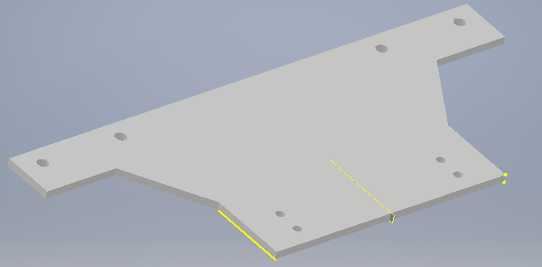
Claw Design
Aluminium plate
Torque calculation
Assumptions:
Plate is rectangular with 3 mm thickness
Holes are neglected
System underwater (Buoyancy against gravity)
Results
Maximum stress = 3 MPa = 0.03 yield stress
Strain = 4 10^-5

Slide 13
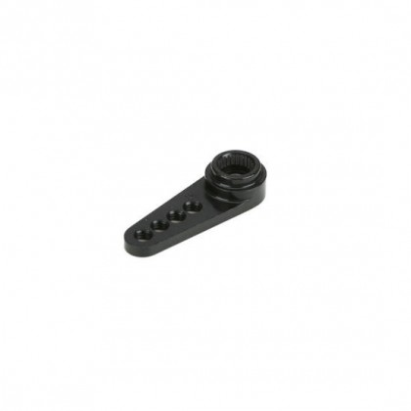
Claw Design
Motor pipe attachment:
Position the motor arm between two aluminium pieces attached to the pipe
Still need torque calculation
Alternative
One aluminium parts attached the servo arm (Bolts M1.6)
two aluminium pieces attached to the pipe

Slide 14
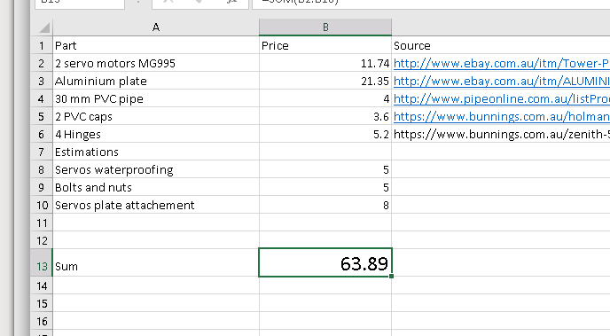
Claw Design
Cost estimation

Slide 15
Claw Design
Further calculations
Weight of the whole claw : 1.3 Kg
Buancy of the whole claw: 6.13 N

Slide 16
Claw Design
Upcoming tasks
Waiting for the aluminium parts from Doug (The waiting list seems to be extremely long)
Cutting the pipe at the STC
Waiting for the motors (they should be here at most by the end of next week)
Connect the servo to the plate ($8 are available for that)
Buy the caps, cut them and attach them to the claw
Waterproofing the servos ($5 Graisse and Plasti Dip)

